Slide 1

Top-of-Funnel Performance Review
Marketing Mix Model Insights for [Brand Name]
JL
by Jiaman Li
Jun 19, 2025

Slide 2
Table of Content
Executive Summary
Business Question & Objective
Methodology & Data Sources
Top-of-Funnel (TOF) Channel Definition
Evaluation Framework
ROI vs. Spend Quadrant Analysis
Channel Correlation & Insights
Top-of-Funnel (TOF) Channels Categorization
Spend Reallocation Opportunity
Strategic Next Steps & Actions
Model Accuracy & Fit
Appendix: Supporting Calculations
Thank You

Slide 3
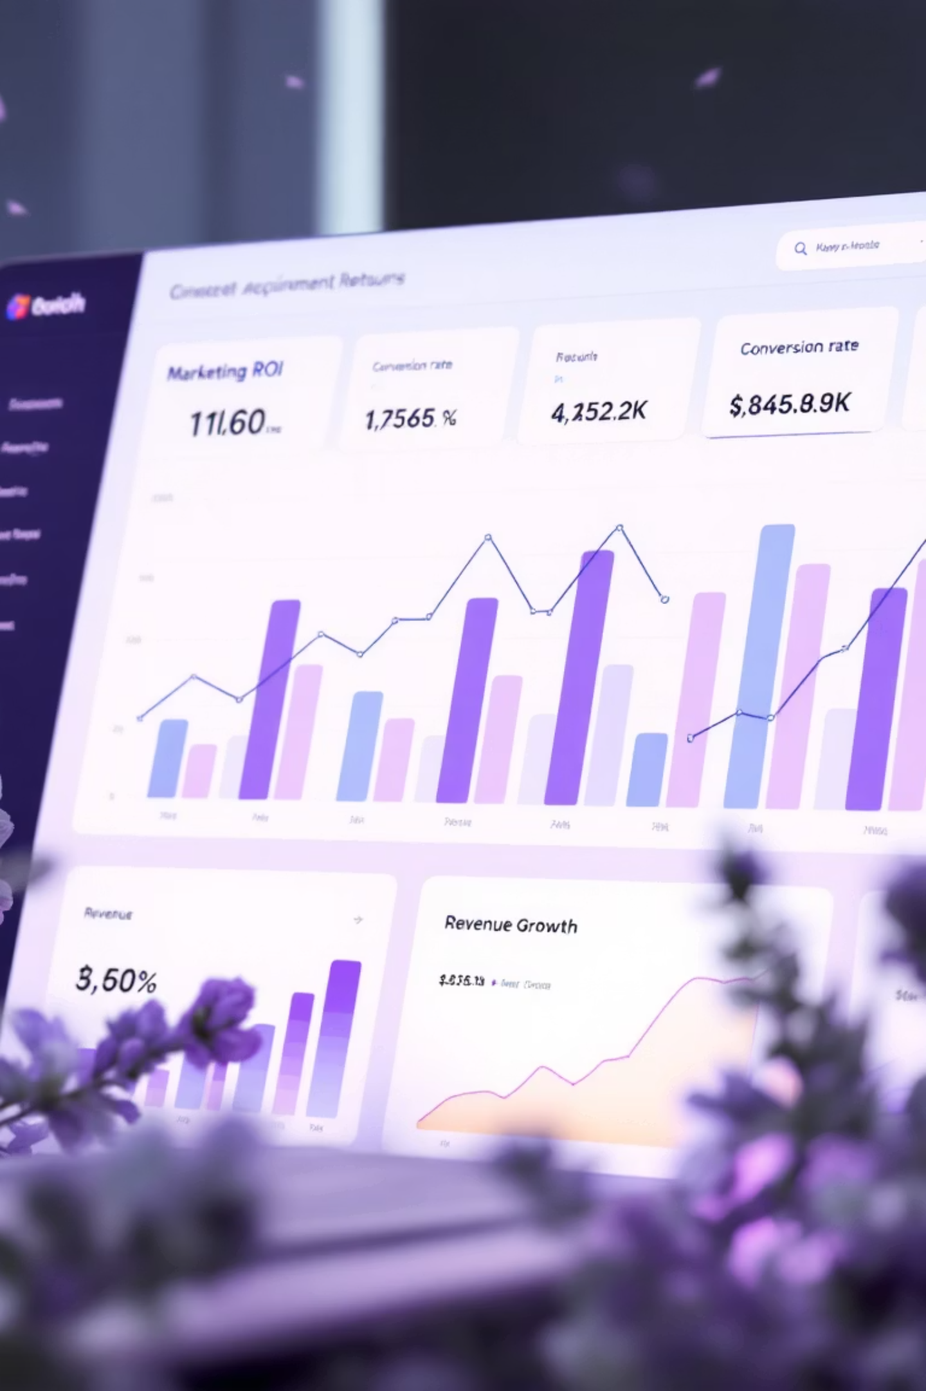
Executive Summary
12 top-of-funnel channels were evaluated using Marketing Mix Modeling (MMM) results.
Identified $263K+ in spend across underperforming channels (ROI < 2), including Facebook Promoting, Influencer Macro/Micro, and Snap.
Reallocating this budget to high-performing channels (e.g., Pinterest, Adwords Non-Brand) could unlock up to $165K～ $221K ( +104% ) incremental revenue.
Channels like TikTok and Facebook AdvShopping show promise but require further testing and refinement.
Next steps include reallocating spend, testing Watchlist channels, and reducing channel overlap.
Note: See Appendix for detailed estimation assumptions and calculations.

Slide 4
Business Question & Objective
Business Context: [Brand Name] is investing across multiple top-of-funnel (TOF) marketing channels to acquire new customers and grow brand awareness.
Key Business Questions:
Which TOF channels are driving strong ROI and revenue?
Are there any underperforming or inefficient channels?
How can we optimize spend to improve marketing efficiency?
Analysis Objectives:
Evaluate performance of all [Brand Name]'s top-of-funnel (TOF) channels using MMM outputs
Identify overperforming and underperforming channels and classify each channel as GOOD, WATCHLIST, or WEAK
Identify high-cost low-return areas and recommend reallocation to improve ROI and revenue

Slide 5
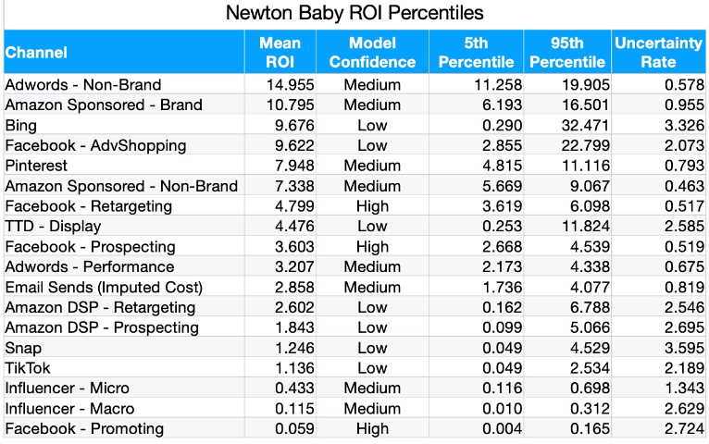
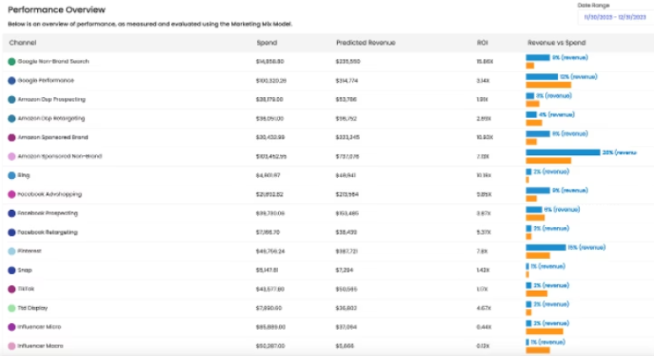
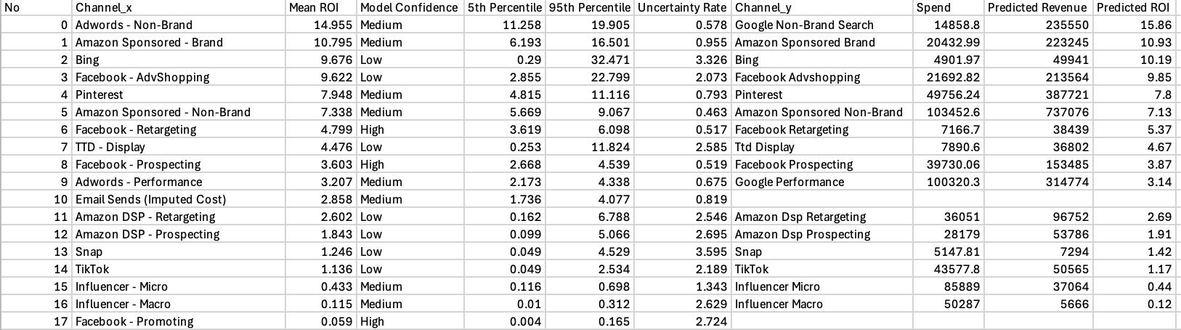
Methodology & Data Fusion
Integrated two core datasets to create a comprehensive view:
Uncertainty Rate Calculation:
ROI Percentiles
Confidence levels and model uncertainty metrics for each channel
Measures how volatile the modeled ROI is
The lower the rate, the more reliable the prediction.
Performance Overview
Revenue and spend estimates based on marketing mix modeling
Note: Channel names have been aligned across data sources for consistency.

Slide 6
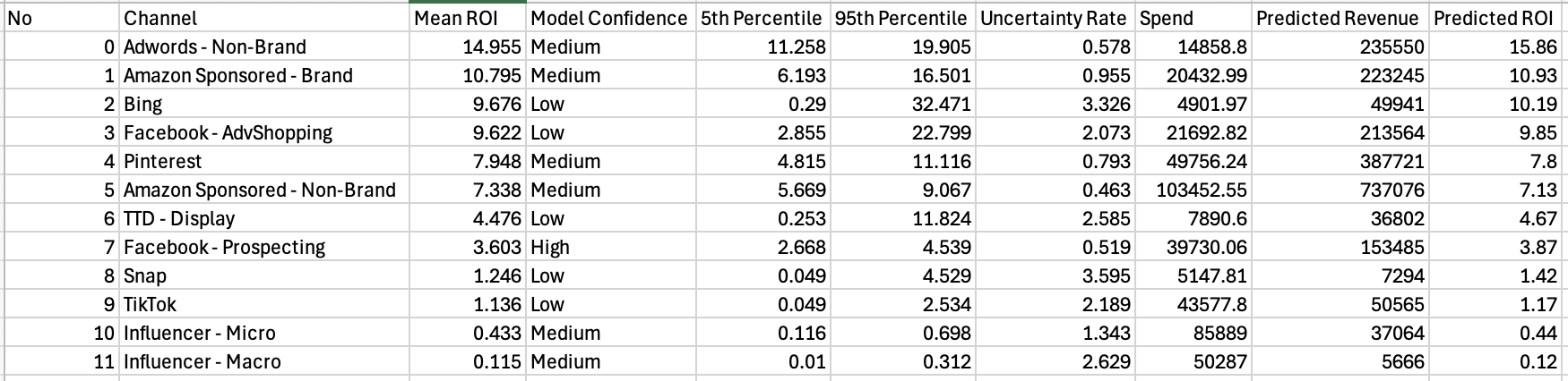
Top-of-Funnel (TOF) Channels
Narrowed focus to true top-of-funnel (TOF) channels: e.g., non-brand search, prospecting, influencer, display, etc.
Excluded clear retargeting or conversion-focused platforms from this analysis.
✅ Included Channels
❌ Excluded Channels
Focus on awareness, discovery, or prospecting:
Focus on retargeting, branded queries, or conversion:
Adwords – Non-Brand
Influencer – Macro
Adwords – Performance
Amazon Sponsored – Brand
Influencer – Micro
Amazon DSP – Prospecting
Amazon Sponsored – Non-Brand
Amazon DSP – Retargeting
Pinterest
Bing
Snap
Email Sends (Imputed Cost)
Facebook – AdvShopping
Facebook – Promoting
TTD – Display
Facebook – Prospecting
TikTok
Facebook – Retargeting

Slide 7
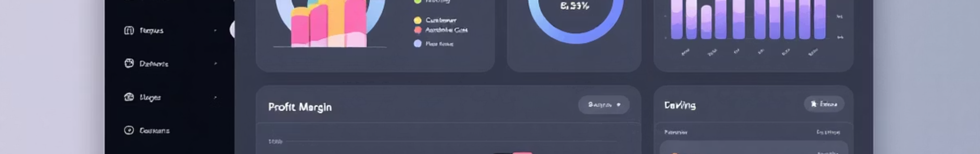




Evaluation Framework
Primary Metrics to Judge "Good vs Bad" Channels.
Expected ROI
Uncertainty Rate
Are returns strong enough to justify continued investment? Higher ROI indicates better channel efficiency.
Can we trust the modeled ROI? Lower uncertainty means more reliable predictions.
Channel Spend
Predicted Revenue
Was investment substantial enough to generate meaningful results? Higher spend improves statistical significance.
Is the revenue contribution material to the business? Larger revenue impact means higher strategic value.

Slide 8
Evaluation Framework: Good vs. Weak Channels
Evaluation thresholds are customized based on this case's channel mix and spend scale.
Each KPI benchmark is grounded in observed model output and practical significance—ensuring the ROI is not only statistically reliable, but also business-meaningful.
GOOD Top-of-Funnel Channel
WEAK Top-of-Funnel Channel
Metric
Threshold
Reason
Metric
Threshold
Reason
Expected ROI
≥ 3.0X
Strong top-line return
Expected ROI
≤ 1.5X
Low return
Uncertainty
< 1.5
Reliable modeling
Uncertainty
> 1.5
Too noisy to rely on
Spend
≥ $10K
Statistically meaningful
Spend
≤ $5K
Insufficient signal
Revenue
< $50K
Minimal impact
Revenue
≥ $100K
Substantial contribution
Note: Watchlist = mixed signals
These benchmarks are tailored to the current brand’s spend level and MMM output distribution.They help distinguish meaningful investment from statistical noise, aligning recommendations with business relevance.

Slide 9
Evaluation Framework: Good vs. Weak Channels
Channel
Uncertainty Rate
Spend
Predicted Revenue
Predicted ROI
Verdict
Reasoning
Adwords - Non-Brand
0.578
14858.8
235550
15.86
✅ GOOD
All 4 metrics meet GOOD thresholds
Amazon Sponsored - Brand
0.955
20432.99
223245
10.93
✅ GOOD
All 4 metrics meet GOOD thresholds
Amazon Sponsored - Non-Brand
0.463
103452.55
737076
7.13
✅ GOOD
All 4 metrics meet GOOD thresholds
Bing
3.326
4901.97
49941
10.19
❌ WEAK
Uncertainty > 1.5, Spend < 5K, Revenue < 50K
Facebook - AdvShopping
2.073
21692.82
213564
9.85
⚠️ WATCHLIST
ROI & Spend ok, but Uncertainty > 1.5
Facebook - Prospecting
0.519
39730.06
153485
3.87
✅ GOOD
All 4 metrics meet GOOD thresholds
Influencer - Macro
2.629
50287
5666
0.12
❌ WEAK
ROI < 1.5, Revenue < 50K
Influencer - Micro
1.343
85889
37064
0.44
❌ WEAK
ROI < 1.5, Revenue < 50K
Pinterest
0.793
49756.24
387721
7.8
✅ GOOD
All 4 metrics meet GOOD thresholds
Snap
3.595
5147.81
7294
1.42
❌ WEAK
ROI < 1.5, Uncertainty > 1.5, Spend < 5K, Revenue < 50K
TikTok
2.189
43577.8
50565
1.17
⚠️ WATCHLIST
ROI < 3, Uncertainty > 1.5, but Spend & Revenue acceptable
TTD - Display
2.585
7890.6
36802
4.67
⚠️ WATCHLIST
ROI ok, Spend ≈ borderline, Uncertainty > 1.5

Slide 10
Evaluation Framework: Good vs. Weak Channels
GOOD
Channel
Mean ROI
Model Confidence
5th Percentile
95th Percentile
Uncertainty Rate
Spend
Predicted Revenue
Predicted ROI
Adwords - Non-Brand
14.955
Medium
11.258
19.905
0.578
14858.8
235550
15.86
Amazon Sponsored - Brand
10.795
Medium
6.193
16.501
0.955
20432.99
223245
10.93
Amazon Sponsored - Non-Brand
7.338
Medium
5.669
9.067
0.463
103452.55
737076
7.13
Facebook - Prospecting
3.603
High
2.668
4.539
0.519
39730.06
153485
3.87
Pinterest
7.948
Medium
4.815
11.116
0.793
49756.24
387721
7.8

Slide 11
WEAK
Channel
Mean ROI
Model Confidence
5th Percentile
95th Percentile
Uncertainty Rate
Spend
Predicted Revenue
Predicted ROI
Bing
9.676
Low
0.29
32.471
3.326
4901.97
49941
10.19
Influencer - Macro
0.115
Medium
0.01
0.312
2.629
50287
5666
0.12
Influencer - Micro
0.433
Medium
0.116
0.698
1.343
85889
37064
0.44
Snap
1.246
Low
0.049
4.529
3.595
5147.81
7294
1.42
WATCHLIST
Channel
Mean ROI
Model Confidence
5th Percentile
95th Percentile
Uncertainty Rate
Spend
Predicted Revenue
Predicted ROI
Facebook - AdvShopping
9.622
Low
2.855
22.799
2.073
21692.82
213564
9.85
TikTok
1.136
Low
0.049
2.534
2.189
43577.8
50565
1.17
TTD - Display
4.476
Low
0.253
11.824
2.585
7890.6
36802
4.67

Slide 12
ROI vs. Spend Quadrant Analysis
Identifies underperforming channels with high spend and low ROI
Key Insights:
Spend ≥ $20K
This plot visualizes marketing efficiency:
Top-left = High ROI, Low Spend → opportunity to scale (e.g., Adwords)
Bottom-right = Low ROI, High Spend → risky or inefficient (e.g., TikTok, Influencer)
Channels like Snap and Macro Influencer absorb significant budget but yield poor ROI.
Expected ROI
Note: While Bing appears high ROI here, it fails on other dimensions (e.g., Uncertainty & low Spend), so it’s flagged as Weak in holistic evaluation.
Quadrant split lines are based on ROI = 3.0 and Spend = $20K thresholds.
ROI ≥ 3.0X
Spend

Slide 13
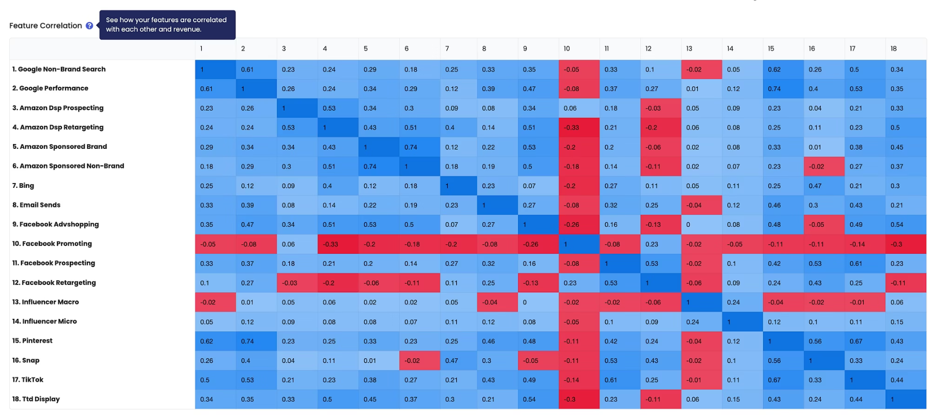
Channel Spending Correlation & Insights
This heatmap reveals how our TOF channel spending levels move together — helping us spot overlap risks and diversification opportunities.

Slide 14
Channel Spending Correlation & Insights
High Spend Correlation (0.50 ~ 0.75)
Medium Spend Correlation (0.35 ~ 0.50)
Low or Negative spending correlation (-0.30 ~ 0.30)
These pairs share tightly linked budgets — often used together to drive sequential touchpoints (prospecting then retargeting).
These channels often scale together as part of a wider brand awareness push, especially for Gen Z and new customer segments.
These spend lines move independently or inversely — useful for audience diversification but need to prove ROI.
Next Step
Next Step
Next Step
Align budgets, pacing, and audience exclusions to minimize overlap and duplicated reach. Coordinate KPIs and avoid double counting
.
Run incrementality tests to confirm unique reach. Adjust spend splits to focus on channels delivering the clearest lift..
Track performance in isolation. Reallocate underperformers to stronger channels if they fail to deliver incremental value..
Example
Example
Example
Sponsored Brand ↔ Non-Brand (0.74)
Amazon DSP Prospecting ↔ Retargeting (0.53)
Facebook Prospecting ↔ Retargeting (0.53)
Snap ↔ TikTok (0.67)
Snap ↔ Pinterest (0.56)
Pinterest ↔ Google Non-Brand Search (0.62)
Facebook AdvShopping ↔ Prospecting (0.16)
Influencer Macro ↔ Paid Channels (~0.00)
Facebook Promoting ↔ Amazon DSP Retargeting (–0.33)

Slide 15



Top-of-Funnel (TOF) Channel Categorization
GOOD Channels
WATCHLIST Channels
WEAK Channels
Adwords - Non-Brand
Amazon Sponsored – Brand
Amazon Sponsored - Non-Brand
Facebook – Prospecting
Pinterest
Bing
Facebook – AdvShopping
TikTok
TTD - Display
Influencer – Macro
Influencer - Micro, Snap
UPDATE:
Regarding Bing - Model confidence is low, the predicted ROI is high (10.19). Understanding that the spend cap is relatively low → Reassess the risk, which suggests it may still Even though be a worthwhile Good TOF channel to invest in.

Slide 16
Spend Reallocation Opportunity
Estimated Incremental Revenue Uplift — Reallocation Impact
Baseline
Underperforming TOF Channels (ROI < 2)
Total Spend: $263,368
Current Average ROI: ~0.6034
Current Expected Revenue: $158,926
Identified $263K+ in spend across underperforming channels (ROI < 2), including Facebook Promoting, Influencer Macro/Micro, and Snap.
Reallocating this budget to high-performing channels (e.g., Pinterest, Adwords Non-Brand) could unlock up to $165K～ $221K ( +104% ) incremental revenue.
Target ROI (High-Performing Benchmark): ~9
Theoretical Expected Revenue: $263,368 × 9 = $2,370,312
Gross Incremental Uplift: $2,370,312 – $158,926 = $2,211,386
Adjustments for Realistic Delivery
Apply marginal diminishing returns: ÷2
Apply realization factor: × 15–20%
Estimated Realistic Incremental Revenue =($2,370,312 – $158,926) ÷ 2 × 15%～20% ≈ $165K～ $221K
Uplift (%) = (Gross Incremental Revenue ÷ Baseline Revenue) × marginal factor × realization factor = $2,211,386 / $158,926​ ÷ 2 × 15% ～ 20% ≈ 104%
Note: See Appendix for detailed estimation assumptions and calculations.

Slide 17





Key Strategic Actions
Scale High-Performing Channels
Refine & Monitor Watchlist Channels
Pause or Reallocate Budget from Underperformers
Increase spend on top performers like Adwords - Non-Brand, Amazon Sponsored - Brand, and Pinterest, which consistently meet ROI, reliability, and revenue thresholds.
For channels like Facebook AdvShopping and TikTok, consider:
Reduce or pause spend on Snap, Influencer - Macro, Facebook Promoting, and Facebook Retargeting, which show either low ROI or negative correlation with revenue (e.g., Facebook Promoting: –0.16).
Running A/B tests or segment-specific campaigns to reduce performance uncertainty.
Closely monitor marginal ROI to identify any diminishing returns as spend scales up.
Investigating creative, audience, or placement strategies to stabilize ROI and reduce volatility.
Shift investment toward higher-performing or testable channels to improve media efficiency.
Leverage strong revenue correlations. Pinterest (0.66) and Adwords Non-Brand (0.62) to prioritize during peak demand periods.
Use upcoming model refreshes to reassess classification based on improvements or degradation.
Reduce Channel Overlap & Cannibalization
Improve Model Confidence Inputs
Coordinate between overlapping campaigns (e.g., Facebook AdvShopping & Prospecting, correlation = 0.64) to avoid audience cannibalization or duplicated attribution.
For low-confidence channels, ensure robust data feeds and accurate attribution tagging.
Prioritize high-spend, high-impact channels for frequent MMM updates to improve forecasting accuracy.
Reassess mix of Amazon DSP Prospecting and Amazon Sponsored Brand (correlation = 0.74) to streamline spend across prospecting and retargeting efforts.

Slide 18
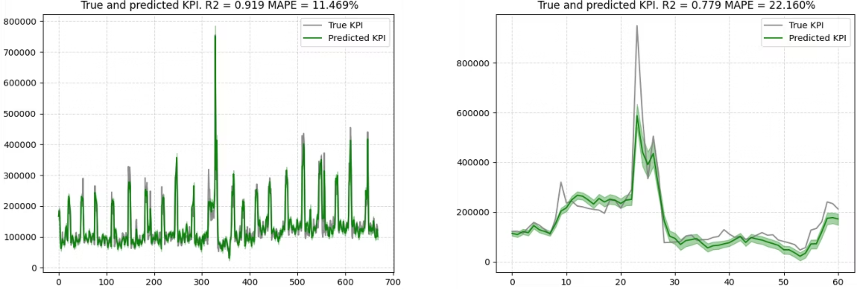
Model Accuracy & Fit Overview
Training Set
Testing Set
Metric
What It Means
Interpretation (Rule of Thumb)
R²
% of variance explained by the model
> 0.75 = Good
> 0.90 = Excellent
MAPE
Avg. % prediction error vs. reality
< 10% = Very accurate
< 25% = Acceptable
R² = 0.919 → The model explains ~92% of the variance in revenue.
R² = 0.779, MAPE = 22.16%
Acceptable accuracy on out-of-sample data, indicating good generalizability.
MAPE = 11.47% → Low average prediction error, high alignment with true performance.
The MMM model is sufficiently accurate to evaluate top-of-funnel channel ROI and inform budget decisions.

Slide 19
Estimated Incremental Revenue Uplift — Reallocation Impact.
Appendix
Channel | Spend ($) | ROI (< 2) | Expected Revenue
Facebook Promoting | 50,287 | 0.059 | 2966
Influencer - Macro | 50,287 | 0.12 | 6035
Influencer - Micro | 85,889 | 0.44 | 37791
Snap | 5,148 | 1.42 | 7316
TikTok | 43,578 | 1.17 | 50988
Amazon DSP Prospecting | 28,179 | 1.91 | 53830
Total | $263,368 | 0.6034 | $158,926
Underperforming TOF Channels (ROI < 2)
Total Spend: $263,368
Current Average ROI: ~0.6034
Current Expected Revenue: $158,926
Channel | Mean ROI | Spend($) | Predicted Revenue ($) | Predicted ROI
Adwords - Non-Brand | 14.955 | 14858.8 | 235550 | 15.86
Amazon Sponsored - Brand | 10.795 | 20432.99 | 223245 | 10.93
Amazon Sponsored - Non-Brand | 7.338 | 103452.55 | 737076 | 7.13
Facebook - Prospecting | 3.603 | 39730.06 | 153485 | 3.87
Pinterest | 7.948 | 49756.24 | 387721 | 7.8
Target high-performing channel average ROI ≈ 9
Average Mean ROI: 8.9278
Average Predicted ROI: 9.118

Slide 20
Appendix
Channel | Spend ($) | Target ROI | Expected Revenue ($)
Facebook Promoting | 50,287 | 9 | 452583
Influencer – Macro | 50,287 | 9 | 452583
Influencer – Micro | 85,889 | 9 | 773001
Snap | 5,148 | 9 | 46332
TikTok | 43,578 | 9 | 392202
Amazon DSP Prospecting | 28,179 | 9 | 253611
Total | $263,368 | 9 | $2370312
Sum of Expected Revenue if reallocated to ROI = 9: $2370312
Apply marginal diminishing returns (÷2)
Apply realization factor (e.g., × 15–20%)
Uplift Amount = ($2370312 - $158,926) ÷ 2 x 15–20% = $165K - $221K
Uplift (%) Uplift (%) = (Gross Incremental Revenue ÷ Baseline Revenue) × marginal factor × realization factor = $2,211,386 / $158,926​ ÷ 2 × 15% ～ 20% ≈ 104%
With assumptions (15–20% effectiveness after discounting for diminishing returns), this reallocation could drive an estimated $165K - $221K incremental revenue, or approximately 104% uplift based on current predicted revenue.
* This represents a conservative scenario for this spend block only.

Slide 21
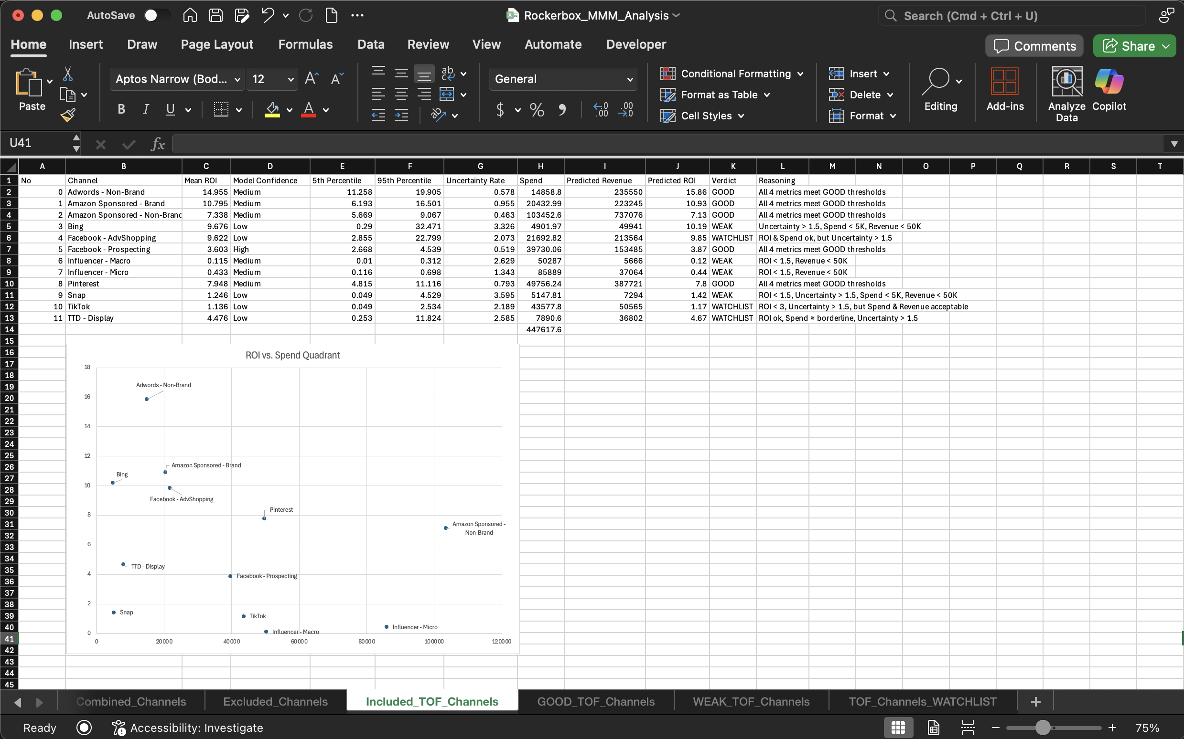
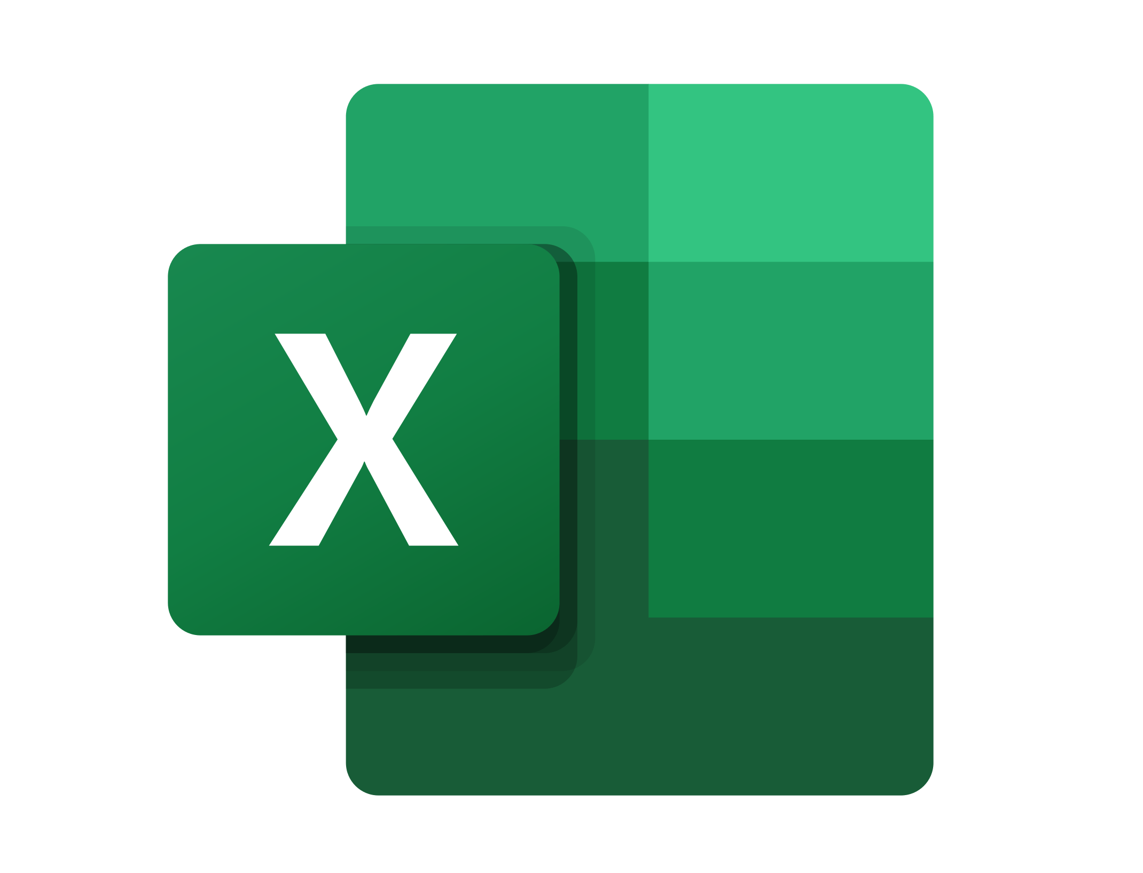
Appendix
MMM_Analysis.xlsx
Click to Download!

Slide 22
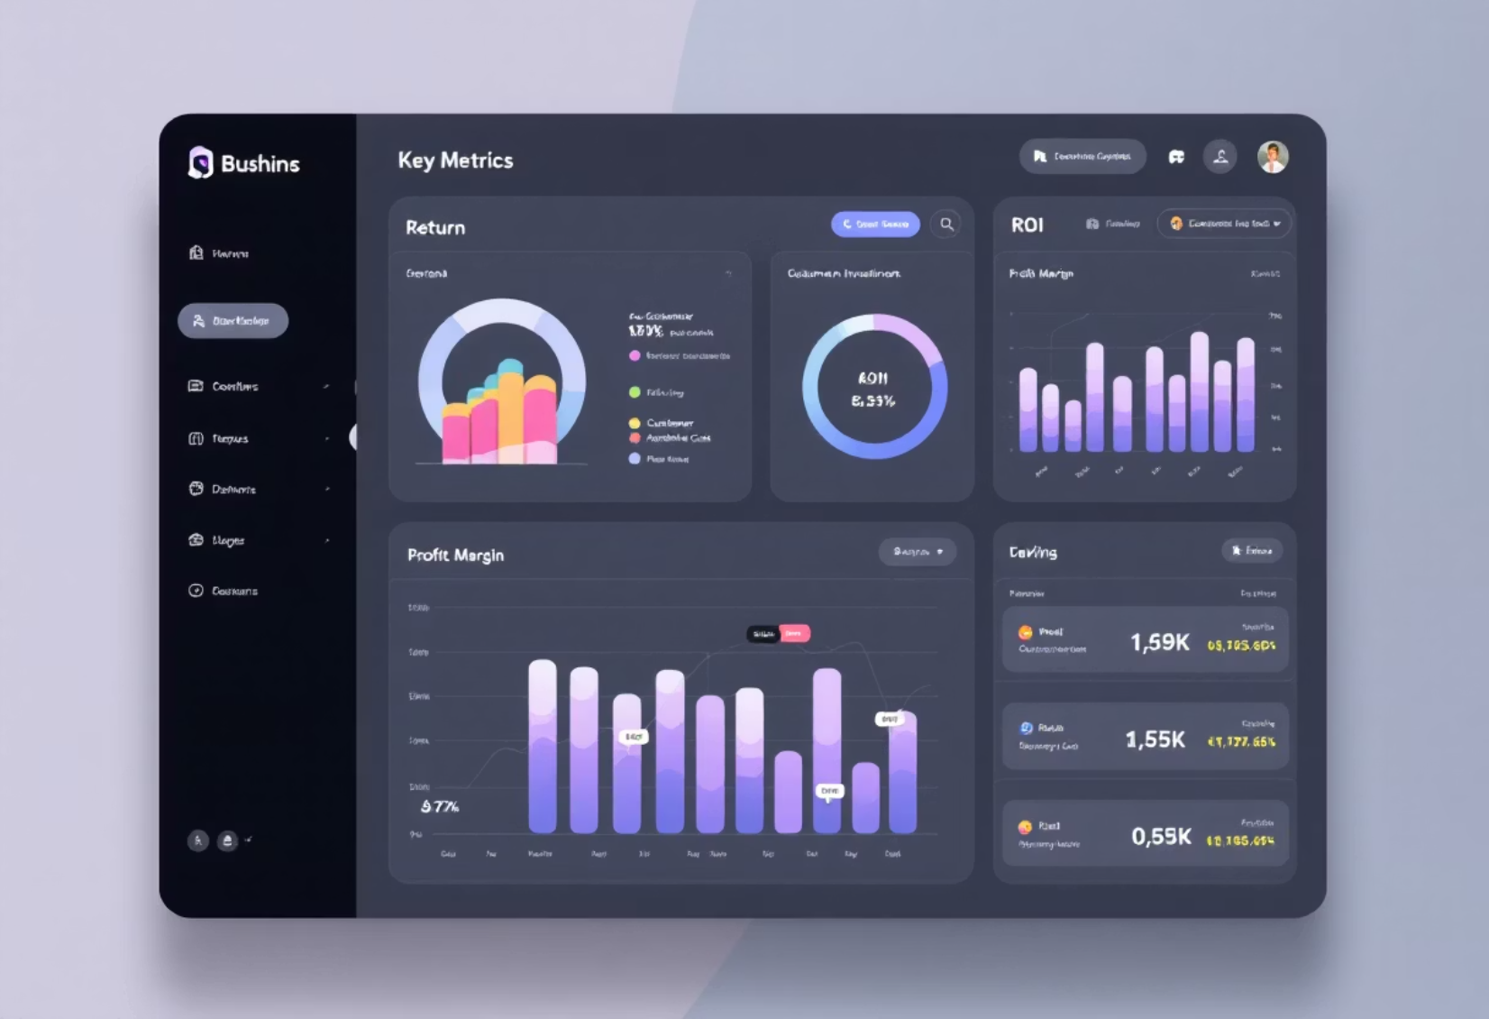
Thanks！
Looking forward to discussing these findings further.

